Slide 1
SyriaTel Telecom Company Churn Analysis and Prediction
Project Manager: DANIEL AKAMA NYAMWEYA

Slide 2
Overview
SyriaTel is a telecommunications company that prides itself in offering top-notch services to their customers. They are the leading telecommunications company in their country and want to remain the leader in that particular sphere. Over the years they have chartered alot of the strides in technology in their country and want to continue improving.
Stakeholders: SyriaTel executives and managers

Slide 3
1. Business Understanding
Problem Statement
In a bid to continue leading SyriaTel is facing a significant challenge, CUSTOMER CHURN i.e. where the customers are discontinuing their services and switch to other service providers. This churn not only leads to revenue loss but also affects the company's market position and customer satisfaction.

Slide 4
Proposed Solution
The proposed solution is to develop a machine learning model that can analyze customer data, including demographics, usage patterns, service subscriptions, to predict customer churn. The model should be able to identify customers who are most likely to churn, enabling the telecommunication company to take proactive measures to retain them.

Slide 5
Project Objectives
To develop a model that will help in predicting if a customer churns or not based on various attributes.
To identify the attributes that heavily impact if a customer is likely to churn.

Slide 6
Project scope and limitations
This project was orchestrated as an extra advisory tool to support top-level management make informed decisions to deal with customer retention.
The project outputs i.e. The model will not be realized as a full application with a user interface but rather a final report on the findings based on the data used which include a number of recommendations.
Internal data from the company will be the primary data source that will drive this project.
Ultimately the final steps taken to mitigate the situation is determined by the company.

Slide 7
Benchmark metric
The bench mark evaluation metric that will be used in this project is ACCURACY.
Justification: from objective 1 we want to know if a customer churns therefore accuracy would be suitable.

Slide 8
2. Data understanding
Once again internal data from the company will be the primary data source that will drive this project.
Here we explored the data to get a better understanding of its state, then decided on the steps we needed to take to clean it. We did the following tasks:
getting the shape of the data (rows and columns).
getting data info (types of features)
descriptive statistics e.g mean, max/min values etc.

Slide 9
Findings on data understanding
From the exercise, the dataset had:
3333 customers.
21 customer features: 4 string predictors, 16 numeric predictors and the target.
Various transformations were applied on the dataset both for analysis and modeling e.g. type conversions, feature selection etc.

Slide 10
3. Modelling
In this section is where the magic happened.
The problem at hand was a classification problem.
We explored 3 models: a baseline model and 2 tuned models.
Model accuracy was the metric for evaluation.
Justification: Accuracy to get a verdict if a customer churns or not.
Accuracy of 70% was the threshold to deem the model as successful.
Rationale why modeling was implemented.
While simpler forms of data analysis, such as descriptive statistics or basic data visualization, can provide initial insights, they may not be sufficient for complex problems or large datasets. Machine learning leverages advanced algorithms to uncover hidden patterns.

Slide 11
Best Model: Model 3
Result: Accuracy on the testing set(unseen/new data): 92%
The accuracy means that the model predicted with an accuracy of 92% whether a customer churned or not.
Justification.
Model 3 proved to have a balanced performance on train and test instances. It demonstrated proper metrics with accuracy score of 92%.
From the graph one can see how each predictor was important in modeling.

Slide 12
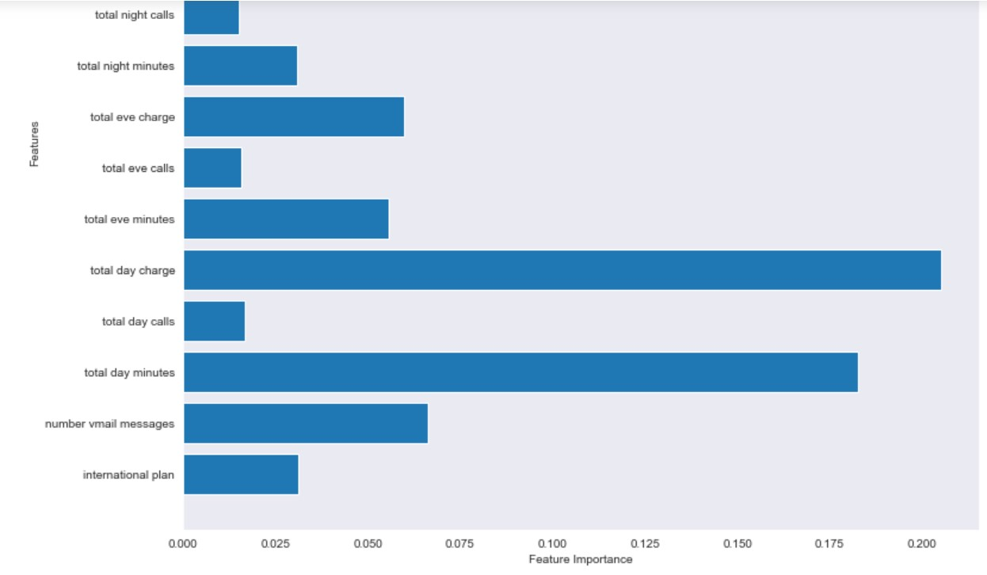
Graph showing feature importance

Slide 13
Findings and Recommendations
Findings.
The following findings were found:
From the modelling exercise, the 3rd model was the best and was able to predict the target with an accuracy of 92%. This means given customer features, it is able to predict churn/no churn with an accuracy of 92%.
The features that heavily determine churn were total day minutes, total day charge, customer service calls.

Slide 14
Recommendations.
The following recommendations were made based on the whole exercise:
Improve Service Quality and Customer Experience: High customer service calls may indicate that customers are experiencing issues or dissatisfaction with the service. To reduce churn, the company should focus on improving service quality, addressing customer concerns promptly, and providing excellent customer support. This can be achieved through staff training, efficient complaint resolution processes, and regular feedback collection to identify and rectify service gaps.

Slide 15
2. Review Pricing Strategies: Since total day minutes and total day charge are influential factors in churn, it is crucial to evaluate the pricing structure and competitiveness. Consider conducting market research and competitor analysis to ensure that the company's pricing is competitive and aligned with customers' expectations. Offering attractive plans, discounts, or incentives for loyal customers can help retain them and discourage churn.
3. Proactive Customer Engagement and Retention Programs: Rather than waiting for customers to reach out with issues or complaints, the company can proactively engage customers through personalized communication and retention programs. This can include sending targeted offers, exclusive promotions, and customized recommendations based on customers' usage patterns and preferences. Building strong relationships with customers and providing them with incentives to stay can significantly reduce churn rates.

Slide 16
Analyze Churn Patterns and Predictive Modeling: Add more data on churn to analyze patterns and trends. Implement predictive modeling techniques in the current systems, to forecast customer churn probability based on various features. By identifying customers who are at high risk of churn, the company can proactively reach out to them with targeted retention strategies and offers, increasing the chances of retaining those customers.

Slide 17
Next steps
1. Implement the recommendations stated.
2. Gather more data for modeling to improve accuracy.

Slide 18
Thankyou

